Slide 1
STANDARD COSTING &VARIANCE ANALYSIS

Slide 2
MEANING
Standard cost is the pre determined cost which determines in advance what each product or service should cost under given circumstances.

Slide 3
STEPS FOR STANDARD COSTING
Determination of Standard cost
Recording Actual Cost
Comparison in standard and Actual cost
Finding out variances
Reporting of variances

Slide 4
SYSTEM OF STANDARD COSTING
Determination of cost centre
Type of Standard
Organization of Standard Costing
Setting of Standards

Slide 5
TYPES OF STANDARD
Current Standard
Ideal Standard
Expected Standard
Basic Standard
Normal Standard

Slide 6
ANALYSIS OF VARIANCE
Sales Variance
Profit Variance
Direct Material variance
Direct Labor variance

Slide 7
Sales Variance
Sales Value variance= Actual value of sales- budgeted value of Sales
Sales price variance = Actual Qty. ( Actual Price- Standard Price)
Sales Volume Variance = Std. Price ( Actual Qty.of sales –std. Qty. of Sales)

Slide 8
Example - 1
The budget and actual sales for a period in respect of the two products are as follows:
Budgeted Actual
Product BQ BP BV AQ AP AV
X 600 3 1800 800 4 3200
Y 800 4 3200 600 3 1800
Calculate Sales Variance

Slide 9
Example - 2
Information Regarding budgeted and actual sales of two products are as follows:
Budgeted Actual
Product BQ BP AQ AP
X 800 10 1000 12
Y 1200 6 1400 5
Calculate Sales Variance

Slide 10
Profit method of Calculating sales variance
1) Total sales margin Variance= actual profit- Budgeted Profit
Actual profit= Act. Qty sold x Act. Profit Per unit
Budgeted Profit = Bud Qty. Sold x Bud profit per unit
2) Sales margin Variance due to selling price=
Act. Qty.( Act. Price- Std. Price)
3) Sales Margin variance due to volume=
std. profit per unit ( Act. Qty. of sales-Std. Qty. of Sales)

Slide 11
Example
Information Regarding budgeted and actual sales of two products are as follows:
Budgeted Actual
Product BQ BP AQ AP
A 500 60 600 65
B 700 40 650 38
The cost per unit of product A & B was Rs55 & Rs32 respectively. Compute the variance of difference between budgeted and actual profit.

Slide 12
Material Variance
Material Cost Variance: Std. Material Cost- Actual mat. Cost
Material price Variance: Act. Qty.( Std. price- Actual Price)
Material usage variance: Std. price ( Std. Qty.- Act. Qty)

Slide 13
Example
The standard qty. of material required for producing one ton of the output is 40 units. The standard price per unit of material is Rs3. during a particular period 90 tons of output was undertaken. The material required for actual production were 4000 units. An amount of Rs 14000 was spent on purchasing the material.

Slide 14
Example
The standard material required for producing 100 units is 120kgs. A standard price of 0.50 paisa per kg is fixed and 2400 units were produced during the period. Actual material purchased were 300,000 kgs at a cost of Rs165000. calculate material variance.

Slide 15
Labor Variance
Labor cost variance: Std. lab. Cost- act. Labor cost
Wage rate variance : Act. Time( Std. Rate- Act. Rate)
Labor Time variance: Std. wage rate (Std. time- Act. time)
Idle time Hrs: Idle hrs X std. Rate

Slide 16
Example:
In a manufacturing concern the standard time fixed for a month is 8000 hrs. a standard wage rate of Rs2.25 per hr has been fixed. During one month 50 workers were employed and average working days in a month are 25. A worker has 7 hrs in a day. Total wage bill of the factory for the month amounts to Rs 21875, there was stoppage of work due to power failure ( idle time) for 100 hrs. calculate labor variance.

Slide 17
Example
The information regarding composition and the weekly wage rates of labor force engaged on a job schedule to be completed in 30 weeks are as follows:
Workers standard Actual
No. of labor Weekly wage rate per hr No. of labor Weekly wage rate per hr
skilled labor 75 60 70 70
Semi skilled 45 40 30 50
Unskilled 60 30 80 20
the worker has completed in 32 hrs. calculate Lab. Variance.

Slide 18
ACCOUNTING BEYOND ACCOUNTABILITY…………

Slide 19
RESPONSIBILITY ACCOUNTING
Responsibility accounting is a system under which managers are given decision making authority and responsibility for each activity occurring within a specific area of the company.

Slide 20
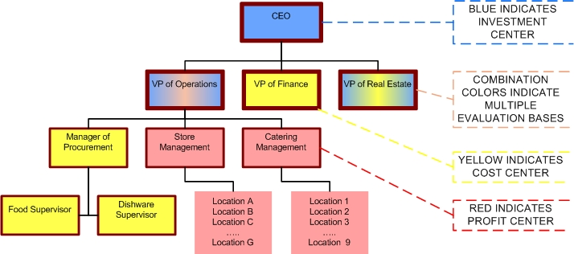

Slide 21
Institute of Cost and Works Accountant of India defines responsibility accounting as a system of management accounting under which accountability is established according to the responsibility delegated to various levels of management and management information and reporting system instituted to give adequate feedback in terms of the delegated responsibility. Under this system division or units of an organization under a specified authority in a person are developed as responsibility centers and evaluated individually for their performance”

Slide 22
BASIC PRINCIPLES
OBJECTIVES
CONTROLLABLE COST
EXPLANATION
MANAGEMENT BY EXCEPTION

Slide 23
BASIC PROCESS IN IMPLEMENTATION
The organization is divided into various responsibility centers.
The targets or budgets of each responsibility centre are set in consultation with the manager of responsibility centre, so that he may be able to give full information about this department.
Managers are charged with items and responsibility over which they can exercise a significant degree of direct control.

Slide 24
Goals defined for each area of responsibility should be attainable with efficient and effective performance.
The actual performance is communicated to the managers concerned.
The performance reports for each centre should be prepared highlighting the variance and items requiring managements section

Slide 25
RESPONSIBILITY REPORTING
Defining and grouping of responsibilities within an organization structure, determination and assignment of cost to appropriate level of activities and strong emphasis and controllability.

Slide 26
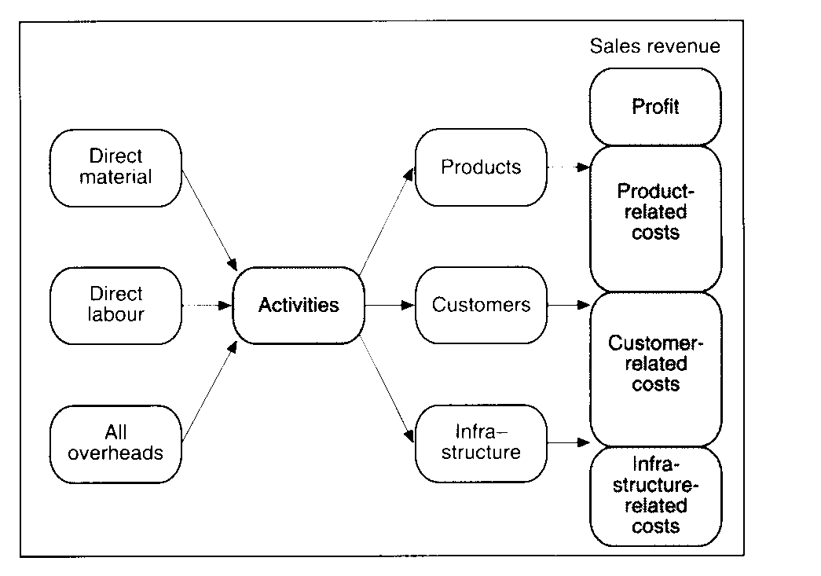

Slide 27
ADVANTAGES
It introduces sound system of control
Each and every individual is assigned some responsibility and they are accountable for their work
It is effective tool of cost control and cost reduction applied with budgetary control and standard costing
It is only control device but also facilitates decentralization of decision making
It fosters a sense of cost consciousness among managers and their subordinates
It measures the performance of individuals in an objective manner.
It helps the management to make an effective delegation of authority and required responsibility as well.

