Slide 1
Barriers to Communicatuion

Slide 2
List all the barriers that you can think of which hamper communication

Slide 3
Physical/
Physiological
Gender
Linguistic
Organisational
Barriers
Psychological
Cultural
Social/ Ethical
Mechanical

Slide 4
Physical/Physiological Barriers
Noise
Time
Distance
Subjective stress
Environmental stress

Slide 5
Linguistic Barriers
Erratum, Corrigendum
Slang
Jargon
Multiplicity of Meanings (Semantics)
Muddled Messages
Difference in Accent, Pronunciation, Stress
Freudian Slip
Syntax

Slide 6
Psychological Barriers
Emotions
Resistance to Change
Difference in Perception
Self-image
Stereotyping
Abstraction
Slanting
Polarisation/ Xenophobia
Horns & halo Effect

Slide 7
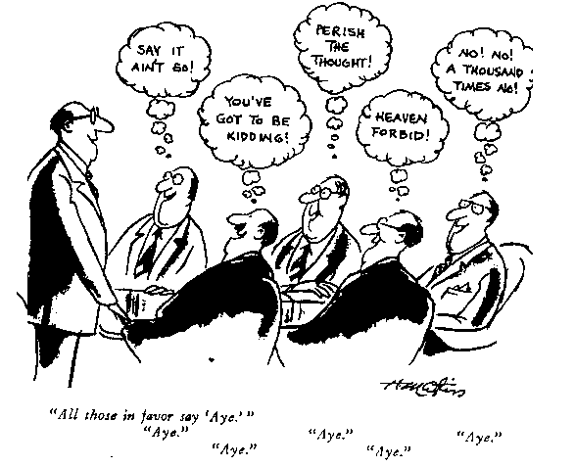
Social/ Ethical Barriers
Conformity
‘Groupthink’ is a term introduced by a North American psychologist, Janis (1982), to explain an extreme type of social conformity occurring within close-knit groups

Slide 8
Social/ Ethical Barriers
‘moral silence’, failing to speak up about issues that are known to be wrong;
‘moral deafness’, failure to hear or attend to moral concerns raised by others;
‘moral blindness’, failure to recognise the moral implications of actions.

Slide 9
Mechanical Barriers
Static while talking on phone
Bad signal while messaging
Low connectivity
Bad handwriting
Smudging on paper
Small print/font size

Slide 10
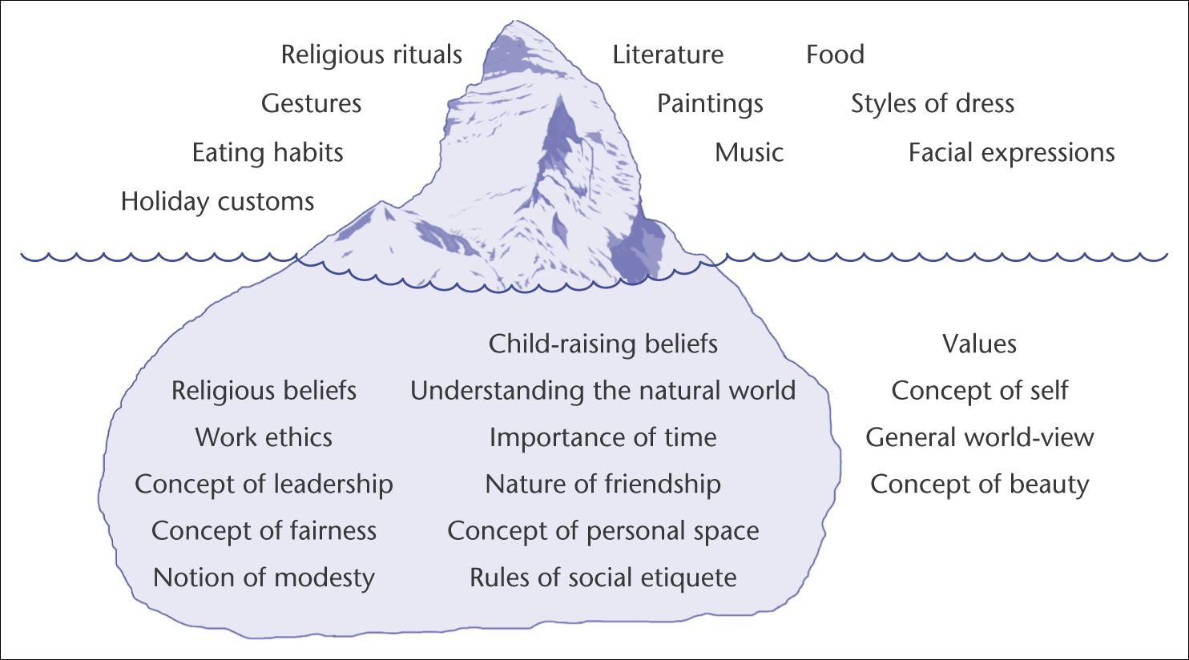
The Iceberg Metaphor for Culture

Slide 11
Organisational Barriers (Downward Communication)
One-Way Communication
Differences in Values and Perceptions
Mistrust
The Psychic Conflicts of Leadership

Slide 12
Organisational Barriers (Upward Communication)
Attitudes of the Subordinates
Attitudes and Actions of Superiors
Characteristics of the Organisation

Slide 13
Organisational Barriers (Lateral Communication)
Increased Specialisation
Lack of Management recognition and Reward
Suppression of Differences

