Slide 1
HUMAN RESOURCE MANAGEMENT
Course Objective : To ensure a clear understanding of Personnel Policies and Practices in order to have maximum and effective utilization of human resources
Methodology : Interactive Lectures , Class Presentations , Class Test, Assignments , Class Discussions , Role Plays , Exercises, Case Study etc
Sessions to be Covered : 12 Sessions
Suggested Readings – Aswathappa
Stephen Robbins
Subba Rao
Monappa
Mammoria
Dessler
Magazines Human Capital, Harvard Business Review
Indian Journal for Training & Development

Slide 2
EVALUATION
Semester Exam 60
Attendance 10
Presentations 30
Presentations from 3rd session onwards
Presentation rules, topics and tentative dates will be given to CR of the class with groups.

Slide 3
Class Session 1---Human Resource Management
Outline
Definition
Meaning of HRM
Core Elements of HRM
Objectives of HRM
Functions of HRM
Scope of HRM
Role of HRM
Challenges of HRM in Indian Economy / Modern Management
Relationship with other social sciences – Approaches to HRM / Interdisciplinary approach
Newspaper Articles

Slide 4
Human Resource Management
Definition 1 – Integration
HRM is a series of integrated decisions that form the employment relationships; their quality contributes to the ability of the organizations and the employees to achieve their objectives

Slide 5
Human Resource Management
Definition 2- Influencing
HRM is concerned with the people dimensions management. Since every organization is made up of people ,acquiring their services, developing their skills , motivating them to higher levels of performance and ensuring that they continue to maintain their commitment to the organization are essential to achieving organizational objectives.
This is true regardless of the type of the organization- govt, business education , health, recreational or social action

Slide 6
Definition 3 Applicability
HRM is planning, organizing directing and controlling of the procurement , development, compensation , integration, maintenance, and separation of human resources to the end that individual, organizational and social objectives are accomplished.
Core Elements of HRM
Organizations ------People ------ Management

Slide 7
Meaning of HRM
It is concerned with management of people from Recruitment to Retirement
To select right person, at the right place for the right job.

Slide 8
Difference between Personnel Mgmt & HRM
HRM | PM
People as important assets who could be used for the benefit of organization and society | People as a tool behavior of whom could be manipulated for benefit of the organization and replaced when worn out ,this department was not treated with respect
Aiming at policies and promoting mutuality – goals, respect, rewards & responsibilities | One way traffic
In turn better economic performance and greater HRD | Emphasis on only performance

Slide 9
Difference between Personnel Mgmt & HRM
A part of strategic business Eg – ICICI Bank every unit of ICICI Bank is a profit making center | Not considered a part
New add-ons like training programmes could be invoked in HRM | A routine activity meant to hire new employees having fixed grades & to maintain personnel records.

Slide 11
HRM OBJECTIVES AND FUNCTIONS
HRM Objectives | Supporting Functions
Societal Objectives | Legal Compliance
SAILs basic objective is customer satisfaction | Benefits
 | Union Management Relations
Organizational Objectives | HRP
TVS Suzuki- emphasis of the company are | Employee Relations
People and quality through quality | Selection
circles | Training and Development
 | Appraisal
 | Placement
 | Assessment
Functional Objectives | Appraisal
Reliance – KRA based on PMS & career mapping exercise, Mfg leadership prog for its senior execs in association with Hewitt | Placement
 | Assessment
Personal Objectives | Training and Development
Eg- DuPont Nylon – a development | Appraisal, Placement, Compensation
Center created for employees, team bldg

Slide 12
SCOPE OF HRM
HRM starts from the employees entry till the exit of the same and hence covers everything under the sun.
Activities
HR Planning
Job Analysis – JD &JS- Eg Wipro – implicit JA & Nirma – explicit
Job Design eg- Bajaj Auto- job rotation and job enrichment
Employees Hiring --Recruitment & Selection
Orientation & Placement, Training & Development eg Dupoint Saint Goabain Satyam –team work practiced, Punjab Tractor- Indvidual

Slide 13
SCOPE OF HRM
Employee and Executive Remuneration Eg-infosys prefers low base of salary& individual negotiation , L&T prefers collective bargaining
Employee Maintenance – Motivation, Communication eg BPOs ,Reliance – PLI for its employees with international cons, Google
Performance Appraisals, Job Evaluation Eg- Polaris & Bajaj Auto- 1-behaviour 2.on results
Industrial Relations – Welfare, Safety& Health eg ONGC,

Slide 14
Role of HRM
Advisory Role
Personnel Policies
Personnel Procedures
Functional Role
Service Role
Eg – Google
HR Managers Today Future
Humanitarian Role Enhancement of Human & Non Human
Resources
Counselor Maximization of people to achieve
organizational goals
Mediator Synergizing IT with HR
Spokesman Managing diverse workforce
Problem Solver
Change Agent

Slide 15
Planning- plan & research about wage trends,labour mkt etc Organizing- manpower and resources Staffing- recruitment & selection Directing- issuance of orders and instructions to follow plan of action Controlling – to regulate the activities Operational Functions of HRM Procurement- planning , Recruitment & Selection , Induction & Placement Development – T & D, Career Planning & Counseling Compensation- Wage & Salary administration Integration Maintenance – improving work conditions, retentions Separation - caused by resignations, retirement, death, medical reasons etc
Managerial functions of HRM

Slide 16
CHALLENGES OF HRM IN INDIAN ECONOMY
World becoming a Global Village eg-GE, ranbaxy, Glaxo, TCS
Corporate Re-organizations eg- Air India & IA,
New Organizational Structures- Virtual , boundary less , flat , Wipro –diversfcn – soaps,edible oils etc Forward & Backward Intg Backward integration M&As
Diverse workforce- eg. Teenagers, Nuclear families, working mothers etc Gen Y
Change in Employee Expectations- more of benefits
People Focus – concept of flexi time –huges software, L&T – nanhi kali, TCS joined Tata Mgmt Training Center for balance scorecard & other systems like PMS , Protection of Interests of Weaker sections
Employee Engagement
Attrition

Slide 17
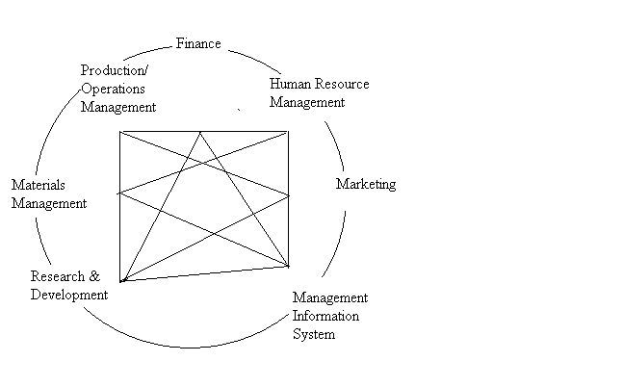
Approaches to HRM / Interdisciplinary Approaches

Slide 18
Changes in Organization Design
1950s | 2000s | Broad Banding
Multiple Layers | Flat/ Delayered | Few levels
Mfg/ lab intensive | Very less control | Empowerment
Autocratic | Team Focused | Merit Pay
Centralized | Adaptive/ Mobility
Tight ownership | Flexible | Few Rules
Individual Contributors | Decentralized | Market Driven
Narrow Responsibilities | Externally Focused

Slide 19
Line & Staff Relationships in Organizations
Relationship which the managers in an organization deal with one another are classified into two categories
Line and staff
Line Relationship - authority and responsibility
Receiving and giving instructions or orders. Important as one gets work done through people.
Staff Relationship –giving and taking of advice

Slide 20
Line Staff Relationships in Orgn
General Mgr
Blue – Staff Relationship
Black – Line Relationship
Mkt Mgr
Fin Mgr
Prod.Mgr
HR Mgr
Dy Mgr
Dy Mgr
Dy Mgr
Dy Mgr
Officer
Officer
Officer
Officer
Officer
Sales
Asst
Asst
Asst

Slide 21
Organization of Personnel Department
Its concerned with the relationships of management to employees
Its concerned with the relationships of employees to employees in all matter
Personnel department is staff deparment and has a structure of line type
Organization of personnel function depends on the size, structure, range and depth of actions, needs, capacities, nature and location of organization.
The degree to which the organization takes personnel function seriously
Scale of operations large – a separate department is essential

Slide 22
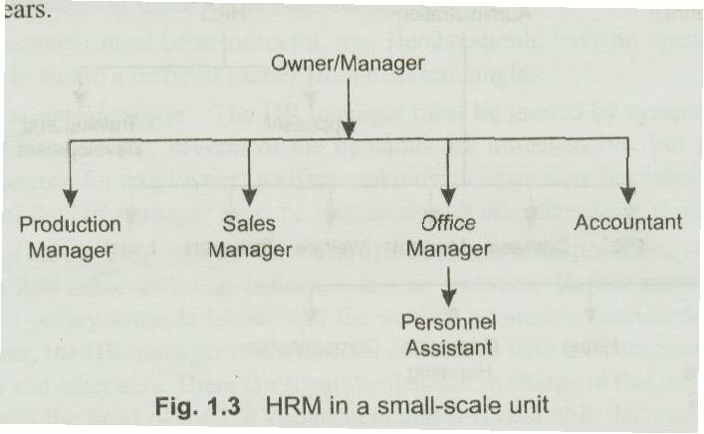
Organizational Structure Personnel Department

Slide 23
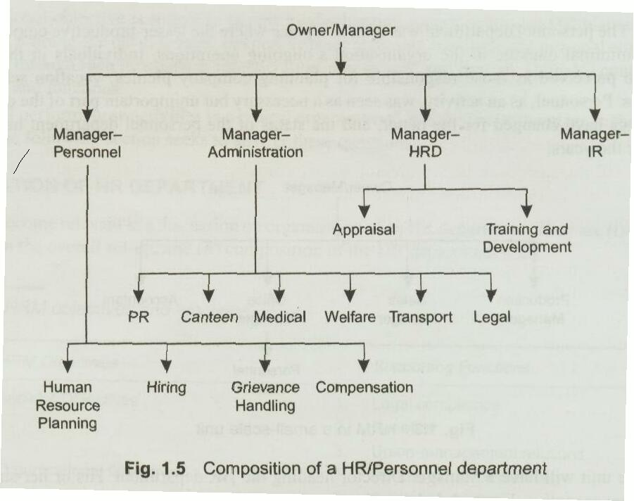
Organizational Structure Personnel Department

Slide 24
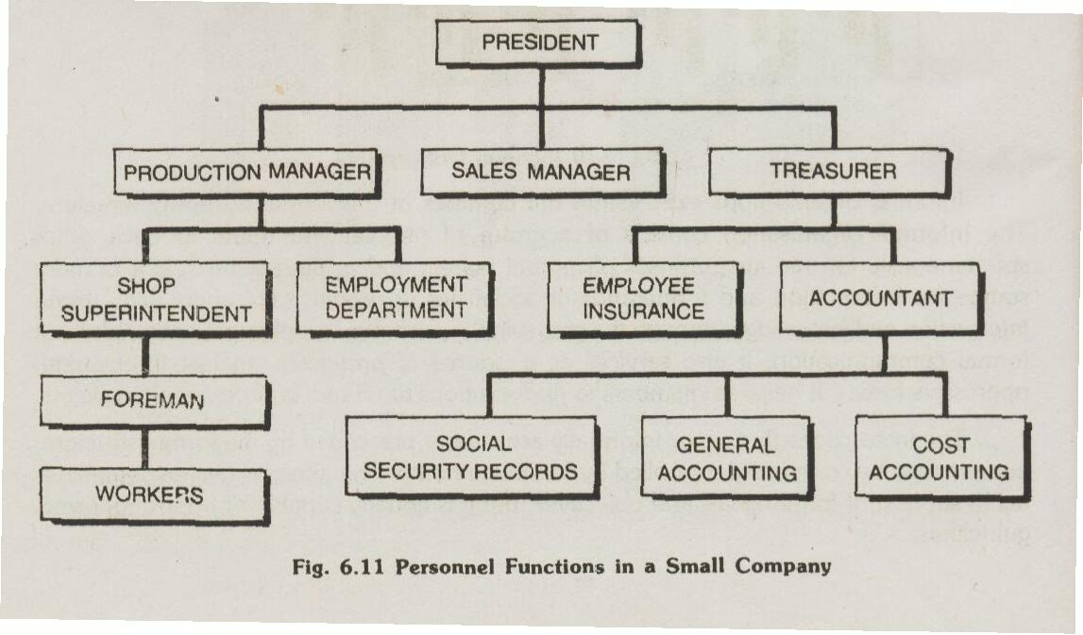
Personnel Department

Slide 25
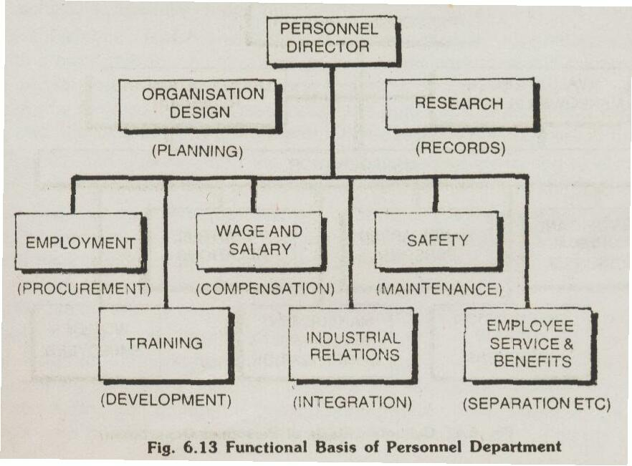
Personnel Department Eg- Hospitals

Slide 26
Personnel Department Eg-FMCG colgate Palmovlie
Levels of Management 3
HR Dept
Vice President HR
3 Managers ( Functional & General
Employees

Slide 27
Personnel Department -g- Pharma cos Merck
Organization Structure
Levels of Management 3
HR Dept Structure
Vice President HR
Sr. Executive HR
Executive HR

Slide 28
Responsibility of Personnel Specialist
Human Resource Planning
Formulation of Programmes & Procedures
Employee Health & Safety Programmes
Training and Development of Personnel
Wage & Salary Administration
Good Labour Management Relations – Grievance handling
Employee Benefit Programmes
Personnel Research
Personnel Audit & Review Work

Slide 29
Airport Authority of India
Functions of Personnel Department
Formulating policies & procedure
Manpower Planning
Training & Development
Recruitment & Promotion
Service Condition
Wage & Salary Administration
PAS & Counseling
Formulation of various welfare schemes

Slide 30
Functional Chart of AAI
Chairman
Secretary
Dep't under Board Members OPS
Finance
Per &A
Planning
Vigilance
Finance & A/cs
Internal Audit
Consultancy
Commercial
Corporate HQ
Corporate HQ
Land Mgmt
Public Relations
Regional HQ
Projects
Airports

Slide 31
Personnel Department Indian Oil Corporation
Executive Dir HR
GM HR
DGM
T&D
HRD

Slide 32
HR/Personnel Dept Shoppers Stop
VP HR
Corporate Mgr HR
Training Manager
Asst Mgr
Training Analyst
Officer HR

Slide 33
Mastek A mix of functional & Matrix Organization
3 Center Heads
Corporate HR Manger
Mastek Development Cell
Personnel Mgmt
Training
OD
Career Path

Slide 34
Oberoi Hotels
Sr.VP HR
Director HR
Training
Human Resource

Slide 35
Summary
HRM is a tool that helps managers to plan, recruit, select, train, develop, remunerate, motivate and make maximum utilization of human and non human resources for the organization and society at large.
“One machine can do the work of fifty ordinary men. No machine can do the work of one extraordinary man.”- Elbert Hubbard

