Slide 1
Current Technologies
Information Technology for Management
ERP
CRM
SCM
Data Warehousing
KM
E-Business (E-Commerce)

Slide 2
Data Warehouse
A data warehouse is the main repository of an organization's historical data, its corporate memory.
It contains the raw material for management's decision support system.
The data warehouse is optimized for reporting and analysis (On Line Analytical Processing, or OLAP).
A data analyst can perform complex queries and analysis, such as Data Mining, on the information without slowing down the operational systems.

Slide 3
Components Of Data Warehouse
Operational,
Historical data
Data warehouse
Extract,
Data
Internal
Transform
Access &
Data
Analysis
Sources
Queries &
Information
Reports
Directory
OLAP
External
Data Mining
Data
Sources

Slide 4
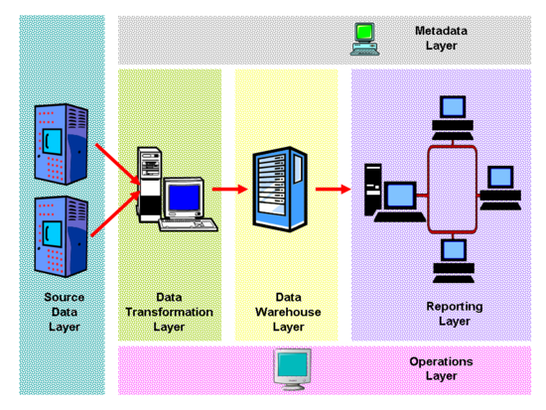

Slide 5
Data Mining
Concerned with analysis of data and use of the software techniques for finding patterns and regularities in sets of data.
Attempt by the system to translate huge amounts of data into knowledge
Analyzes patterns
Some examples…..
Credit Card Companies red-flagging purchases out of the “norm”

Slide 6
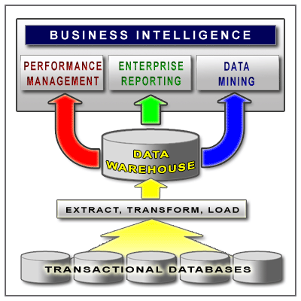
Phases of Knowledge Extraction:
Selection
Preprocessing
Transformation
Data Mining
Interpretation and Evaluation

Slide 7
“The basic economic resource is no longer capital, nor natural resources, nor labor. It is and will be knowledge.”
Peter Drucker

Slide 8
KM
The systematic process of creating, maintaining and nurturing an organization to make the best use of knowledge to create business value and generate competitive advantage.
Capturing knowledge
Storing knowledge
Creating knowledge
Distributing knowledge
Sharing knowledge
Using knowledge
Transfer knowledge from the individual to the collective realm

Slide 9
Knowledge Technology
(The hardware, software and the hype.)
Knowledge repositories
Neural systems
Data-mining tools
Contact software
Intranets
Extranets
Water Cooler Technology

Slide 10
Knowledge Repositories
Tool used to store information
Also known as Data Warehouses
Examples:
Discussion databases
Best practices repository
Lessons Learned
Learning Histories

Slide 11
Major KM Organizations
Institute for Knowledge Management
Knowledge Management Consortium International
American Productivity and Quality Center
Society for Organizational Learning
The International Soc. for Knowledge Organization
The Gartner Group
The Delphi Group

