Slide 1
MIS in Practice
Types of Information Systems (IS)

Slide 2
Types of IS
They are:
Transaction Processing Systems (TPS)
Management Information Systems (MIS)
Decision Support Systems (DSS)
Management Reporting Systems (MRS)
Knowledge Based Systems (KBS)
Office Automation Systems (OAS)

Slide 3
Management Reporting System (MRS)
MRS is an element of MIS.
It is a system for
providing
standardized reports
based on well-known
procedures and rules.

Slide 4
Management Reporting System (MRS)
It is a complex, multistage activity which takes place in the context of other business processes.
It makes use of the multiple information systems -- general documentation, project management, financial control, email communication and business presentation.
Managers take information from these sources, which is combined, summarized, and reinterpreted in management reports.
For example: Sample Reports

Slide 5
Management Reporting System (MRS)
Areas | MRS
Impact | Based on structured tasks (rather than problems) where policies, procedures and rules can be reliably pre-defined.
Pay Off | In improving efficiency by reducing costs, turnaround time and so on, replacing clerical personnel.
Relevance | Has been indirect. Eg: by providing reports and access to data.

Slide 6
Knowledge System
It is a computer based system that represents knowledge.
It makes knowledge available to users in a form tailored to the solution of specific problems.
Knowledge System technology is evolving.

Slide 7
Types of Knowledge System
Hypertext
Interactive Video
Expert Systems

Slide 8
Hypertext System
Provides hypertext documents which store:
text, graphs, diagrams, schematics and other graphics in computer media.
This system becomes knowledge system because of its capacity to store the access paths in the document.
So experts can establish access paths for non-experts to follow.
For example: Encyclopedia

Slide 9
Interactive Video
It links video segments via menu processing applications.
This allows knowledge stored in video media to be accessed non-sequentially.
They involve a greater degree of computer control.
For example: Airlines uses interactive video to train personnel on procedures for the use of new equipments.

Slide 10
Expert System
Decisions, Decisions, Decisions
Artificial Intelligence
Expert System

Slide 11
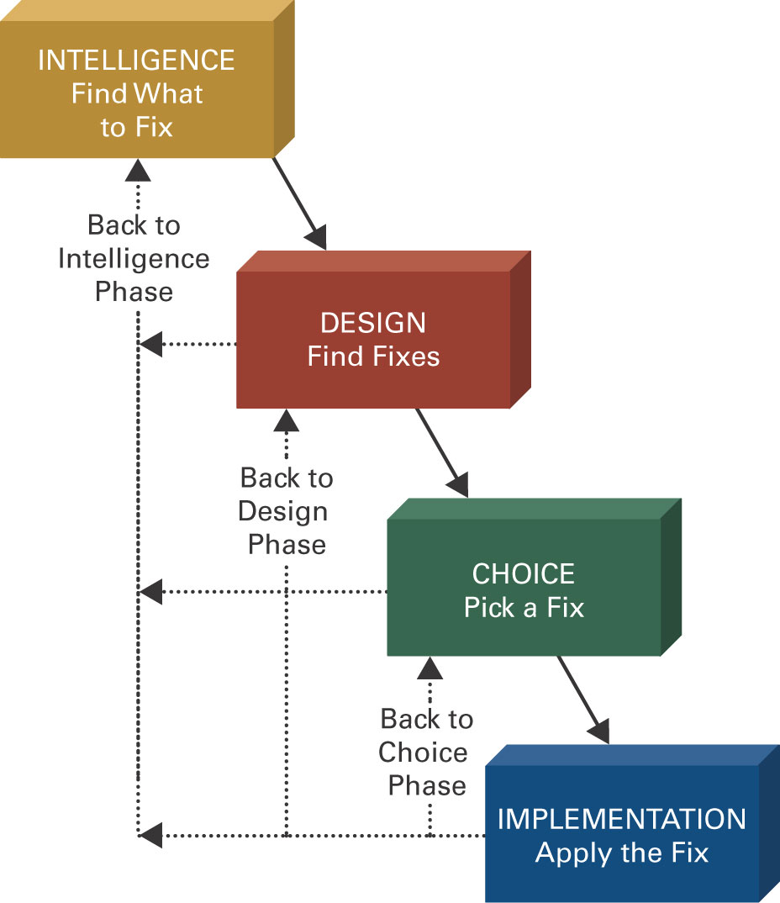
Decisions, Decisions, Decisions How You Make a Decision
Four
phases
of
decision
making

Slide 12
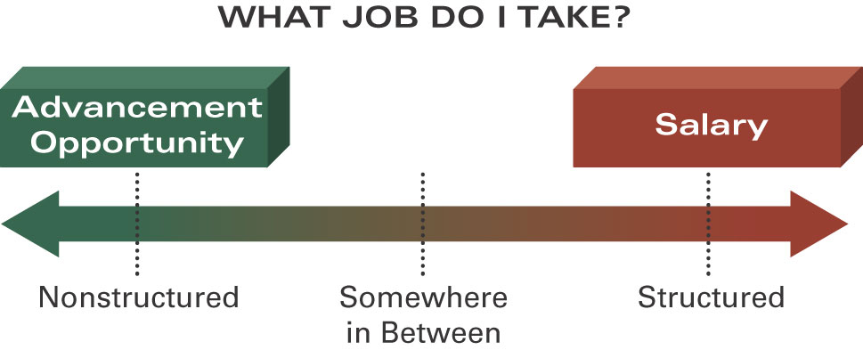
Decisions, Decisions, Decisions Types of Decisions You Face

Slide 13
Artificial Intelligence
Artificial intelligence (AI) - the science of making machines imitate human thinking and behavior.
For example : Robot - mechanical device equipped with simulated human senses and the capability of taking action on its own.

Slide 14
Expert System
Artificial Intelligence system that applies reasoning capabilities to reach a conclusion.
Expert systems are good for diagnostic (what’s wrong?) and prescriptive (what to do?) problems.
An expert system combines information, people, and IT components.

Slide 15
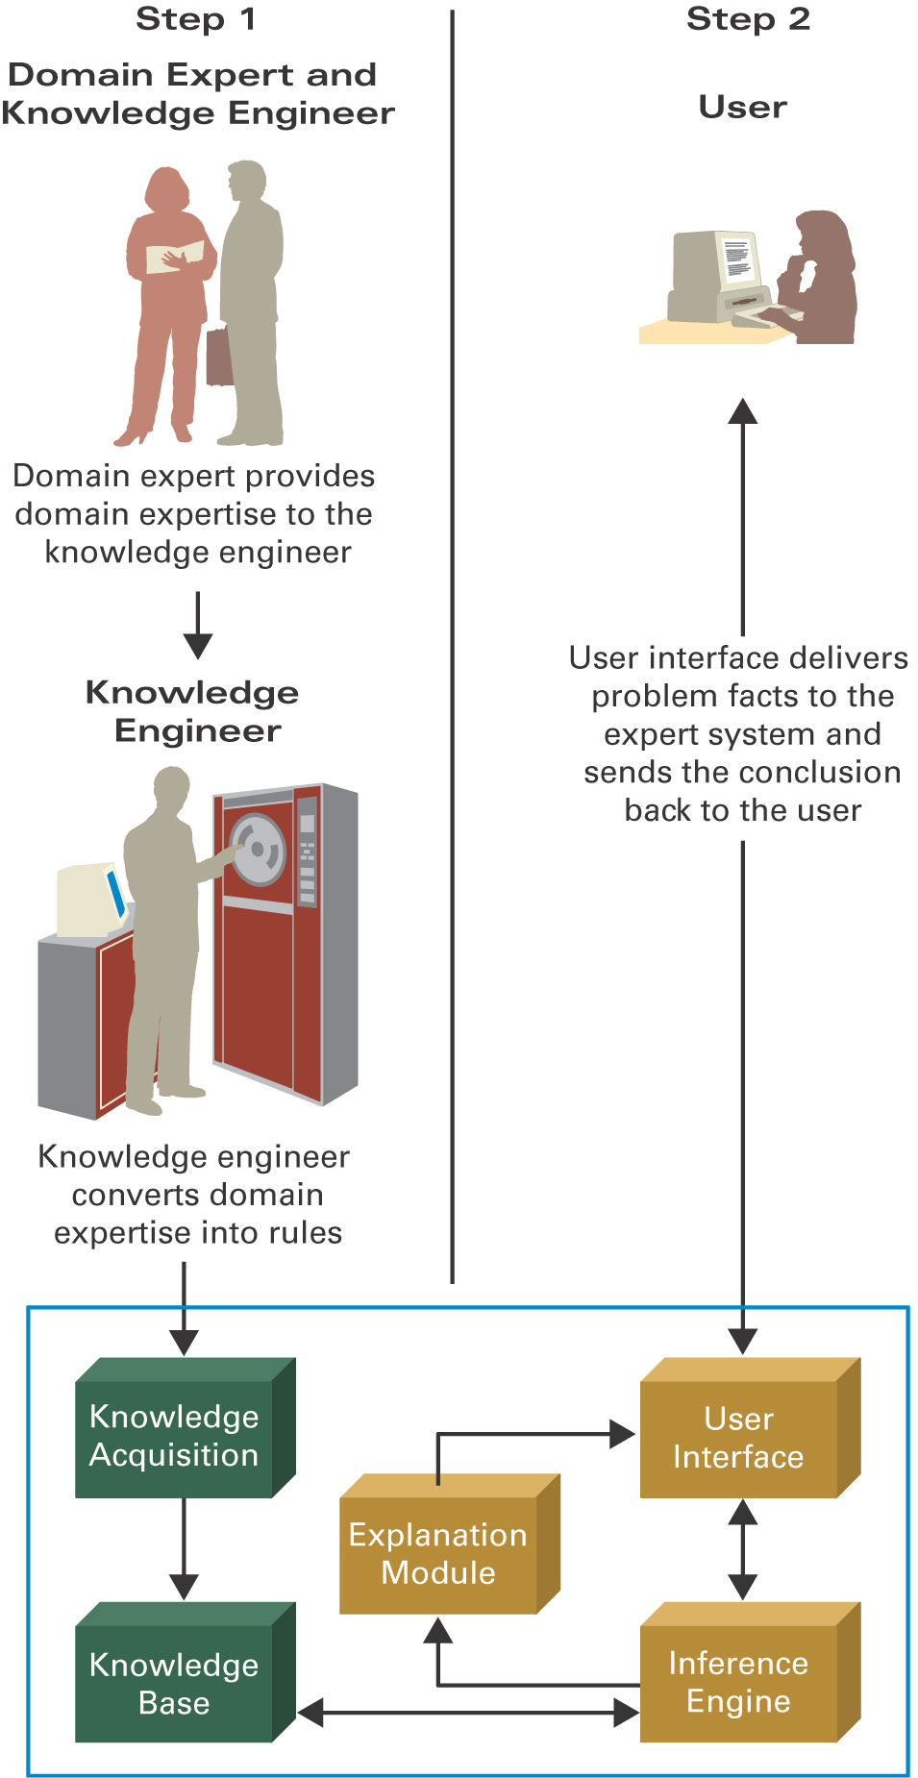
Components of an Expert System

Slide 16
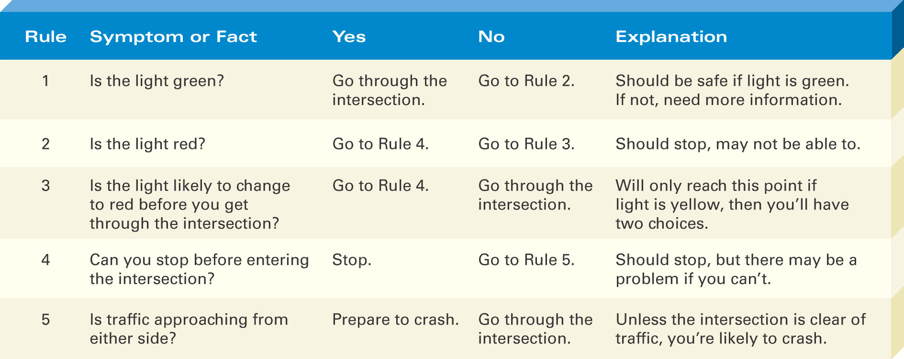
Example :Traffic Signaling System

Slide 17
What Expert Systems Can and Can’t Do
An expert system can:
Reduce errors
Improve customer service
Reduce costs
An expert system can’t:
Use common sense
Automate all processes
On Your Own
Traffic Lights

Slide 18
Office Automation Systems (OAS)
Office automation system is used to digitally:
create, collect, store, manipulate, and relay office information needed for accomplishing basic tasks and goals.
The basic activities of an office automation system are:
Raw data storage, electronic transfer, and the management of electronic business information.

Slide 19
Characteristics:
Used as a facilitator of office correspondence and communication for all the activities.
Office Automation helps in optimize or automate existing office procedures.
The backbone of office automation is a LAN, which allows users to transmit data, mail and even voice across the network.

Slide 20
Facilities of OAS:
Word processing, which includes:
dictation,
typing,
copying, e.t.c
Electronic-filing
Electronic mail
Data and voice Communication, which includes:
fax, telex,
telephone and telephone switchboard operations (PBX)

