Slide 1
ORGANIZATIONAL BEHAVIOUR
Course Objective : To ensure an understanding of the individuals, organizations concept and challenges faced by organizations and individuals to attain organizational and individual objectives with the subsystems and systems.
Methodology : Interactive Lectures , Class Presentations , Class Test, Assignments , Class Discussions , Role Plays , Exercises- To design various forms letters and documents , Case Study etc
Sessions to be Covered 13
Suggested Readings Organizational Behaviour Stephen Robbins
Organizational Behaviour Fred Luthans
Organizational Behaviour K Aswathapa
Magazines Human Capital, Harvard Business Review
Indian Journal for Training & Development

Slide 2
Evaluation Pattern
Semester Exam 60 Marks
Test 20 Marks
Presentation 20 Marks ( Book Reviews )
Presentations would start from 3rd session
One presentation per class

Slide 3
Book Reviews
Rules for the Book Review Presentation
Presentation would be for 8 mins
Presentation would be team effort.
Teams would be 6 members in 1 team
Vivas after presentation in class
One presentation per class
Formal Dress code for presentation
Who moved my cheese Roll Nos. 1,3,5,7,9,11
Stay Hungry Stay Foolish Roll Nos. 2,4,6,8,10,12
From Good to Great Roll Nos 13,15,17,19,21,23
80 / 20 Rule by Kamath Roll Nos 14,16,18, 20,22, 24
Marriage of 2 states Roll Nos 25,27,29,31,33,35,37
7 Habits of highly Effective People Roll Nos 32,34,36,38,39, 40, 43, 45,47
8th Habit of Stephen Covey Roll Nos 38,40,42, 44, 46, 48
The monk who sold his Ferrari Roll Nos 49, 50, 51, 53, 55,57
Who will cry when you dies Roll Nos 52,54,56,58,59,60
Tuesdays with morrie

Slide 4
Interpersonal Section
Role
PLAN OF ACTION
Exercise of defining what is role

Slide 5
ROLE CLARITY
What is a role ?
Who decides the role ?
What parameters are important in a role ?
Who defines the role ?
Is the task same when we talk about professional role and family role ?
Do we have a freedom to choose ?

Slide 6
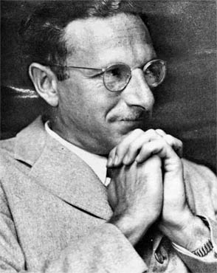
About TA
Proposed by Dr. Eric Berne in mid 1960’s in his book “Games People Play”
Popularized by Thomas A. Harris, author of the book I'm OK - You're OK, and Muriel James, author of Born to Win.

Slide 7
When two people interact with each other they engage in social transactions in which one person responds to the another.
Study of such “social transactions” is known as Transactional Analysis.
It is used to study and analyze interpersonal communication

Slide 8
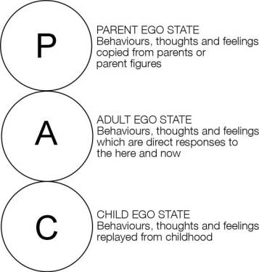
Ego States:
For example, in the workplace, an adult supervisor may take on the Parent role, and scold an adult employee as though they were a Child. Or a child, using their Parent ego-state, could scold their actual parent as though the parent were a Child.
E.g. Sometimes wanting to be naughty in the class, eating all sorts of eateries in the class

Slide 9
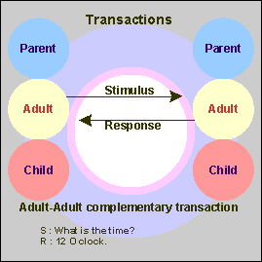
Kinds of Transactions:
Complementary Transaction

Slide 10
Complimentary Transactions
Example 1
A: "Have you been able to write the report?“
B: "Yes - I'm about to email it to you." ----(This exchange was Adult to Adult)
Example 2
A: "Would you like to skip this meeting and go watch a film with me instead?"
B: "I'd love to - I don't want to work anymore, what should we go and see?" (Child to Child)
Example 3
A: "You should have your room tidy by now!" (Parent to Child)
B: "Will you stop hassling me? I'll do it eventually!" (Child to Parent)

Slide 11
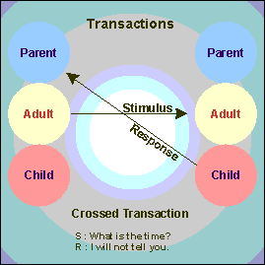
Crossed/ Blocked Transaction

Slide 12
Crossed Transactions
Example 1a:
A: "Have you been able to write that report?" (Adult to Adult)
B: "Will you stop hassling me?
I'll do it eventually!" (Child to Parent) is a crossed transaction likely to produce problems in the workplace.
"A" may respond with a Parent to Child transaction.
For instance:
A: "If you don't change your attitude, you'll get fired."
Example 2a:
A: "Is your room tidy yet?" (Parent to Child)
B: "I'm just going to do it, actually." (Adult to Adult) is a more positive crossed transaction. However there is the risk that "A" will feel aggrieved that "B" is acting responsibly and not playing their role, and the conversation will develop into:
A: "I can never trust you to do things!" (Parent to Child) B: "Why don't you believe anything I say?" (Adult to Adult)

Slide 13
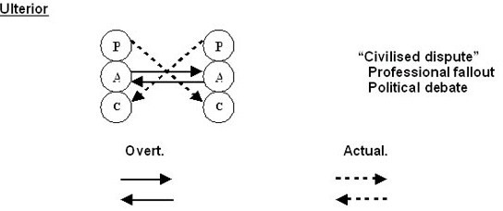
Ulterior Transaction

Slide 14
Stroking:
Positive
Negative
A key idea is that people hunger for recognition, and that lacking positive strokes, will seek whatever kind they can, even if it is recognition of a negative kind. We test out as children what strategies and behaviours seem to get us strokes, of whatever kind we can get.

Slide 15
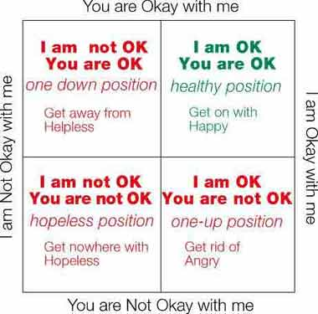
Life Positions:

Slide 16
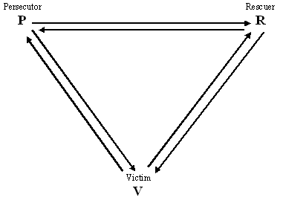
Games:

Slide 17
Advantages of TA:
Improves interpersonal communication
Simple to learn
Applicable in Motivation
Helps in Organizational Development
Can be used at home as well as in office

Slide 18
Disadvantages of TA:
Few scientific facts to prove
Inhibits “cuteness” rather than an insight into human behavior
Ego states are difficult to define.

Slide 19
ORGANIZATIONAL ROLE
What role you play is not more important than the role itself
How do you define the role of employees in the organization
Who defines your role
Do you have the freedom to choose

Slide 20
ROLE
Roles are sets of shared expectations about who should do what under a given set of circumstances.
It is a complex and necessary organizational component.
While the organization's definition of a role may be identical for two people, the way in which they work and their effectiveness and success may vary.
It is therefore important that the individual roles are clarified by operational zing the interactions and expectations that govern their behavior

Slide 21
ROLE CLARITY
A preview of
RANG DE BASANTI
LAGAAN

Slide 22
RANG DE BASANTI
GIST OF THE FILM
CRITICAL ANALYSIS
TAKE AWAYS

Slide 23
Thank You ☺

