Slide 1
Probability and Distribution Function

Slide 2
Random Experiment: An experiment whose outcome is uncertain.
Sample Space (S): A set of all elementary outcomes of an experiment.
E.g. 1. A coin is tossed; S = {H, T}
2. A die is rolled; S = {1, 2, 3, 4, 5, 6}
3. A Coin is tossed twice; S = {HH, HT, TH, TT}
Sample points: Elements of a sample space.

Slide 3
Event: A phenomenon that may or may not be observed as a result of the experiment. Also, defined as a subset of sample space.
E.g. a) In tossing of a coin,
A: The coin falls on Head; A = {H}
b) In tossing a coin thrice,
S = {TTT, HTT, THT, TTH, THH, HHT, HTH, HHH}
B: Head on all tosses B = {HHH}
C: Heads and Tails are alternate
C = {HTH, THT}
D: At most two heads
D = {TTT, HTT, THT, TTH, THH, HHT, HTH}

Slide 4
Probability
If an experiment can result into any one of n mutually exclusive and equally likely outcomes of which m are favourable to an event A, then probability of an event A is given by
P(A) =

Slide 5
Properties of Probability
0 < P(A) < 1
2. If m outcomes out of n are favourable to event A, remaining (n-m) outcomes will be favourable to Ā, so that P(A) = m/n and P(Ā) = (n-m)/n
Thus P(A) + P(Ā) = 1

Slide 6
Probability Distribution
If a coin is tossed thrice, the sample space
S = {TTT, HTT, THT, TTH, THH, HHT, HTH, HHH}
Let X: Number of heads
Value of X | Outcomes | Probability
0 | TTT | 1/8
1 | TTH, THT, HTT | 3/8
2 | HHT, HTH, THH | 3/8
3 | HHH | 1/8

Slide 7
Here X assumes different values depending upon the occurrence of the number of heads. Hence X will be called as a RANDOM VARIABLE.
When X is listed with the corresponding values of probabilities is called as a PROBABILITY DISTRIBUTION of the random variable X.
X is called as a DISCRETE Random variable as it assumes INTEGER values only.
The distribution can be written as:
X: 0 1 2 3
P(X=x): 1/8 3/8 3/8 1/8

Slide 8
It is also called as Probability Mass Function (PMF), and can also be written as P(x).
0 < P(x) < 1 for each x
Sum of all probabilities is always = 1

Slide 9
Expectation and Variance
E(X) = ΣxP(x)
V(X) = Σx²P(x) – [E(X)]²

Slide 10
NORMAL DISTRIBUTION

Slide 11
The most widely used continuous probability density function of a continuous random variable X is given by
= 0 ; otherwise
The random variable in this case is said to follow a Normal Distribution with parameters μ and σ.
The graph of y = f(x) is known as the normal curve.

Slide 12
PROPERTIES OF NORMAL DISTRIBUTION AND NORMAL CURVE
Mean = median = mode = μ.
Standard deviation = σ.
As x moves away from μ, the curve comes closer to the x-axis and extends till infinity on both sides without touching the x-axis.
The normal curve is a symmetric bell-shaped curve; symmetric about x = μ.
The total area under the normal curve = 1.
A normal variate with mean (μ) = 0 and standard deviation (σ) = 1 is known as standard normal variate and is usually denoted by Z.

Slide 13
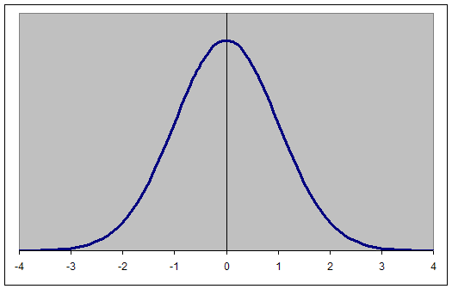
Curve of a Standard Normal Variate

Slide 14
Area under the standard normal curve
The area to the left of Z = 0 is same as that to the right of Z = 0 i.e. 50% or 0.5.
To convert a normal variable X to a standard normal variable Z, we use the following transformation: Z = X – μ
σ
P(Z < Z₀) = Area to the left of Z₀
P(Z > Z₁) = Area to the right of Z₁
P(Z₂ < Z < Z₃) = Area between Z₂ and Z₃

