Slide 1
Non-verbal Communication

Slide 2
The Ten Commandments
Apparel and Artifacts
Kinesics (Body Language)
Posture
Gesture
Facial Expressions
Oculesics (eye contact)

Slide 3
The Ten Commandments (cont…)
Haptics/ Tactilics
Proxemics
Paralanguage
Chronemics
Silence

Slide 4
Attire

Slide 5
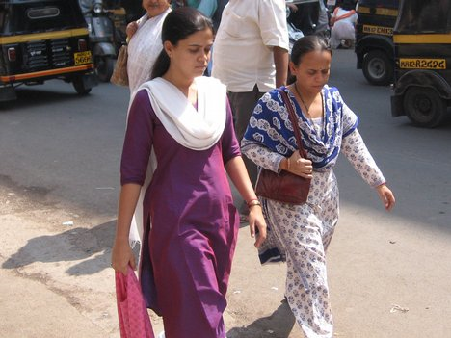
Attire

Slide 6
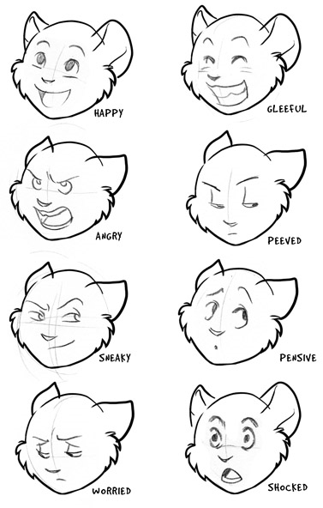
Facial Expressions

Slide 7
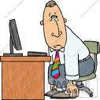
Posture

Slide 8
Attitude matters

Slide 9
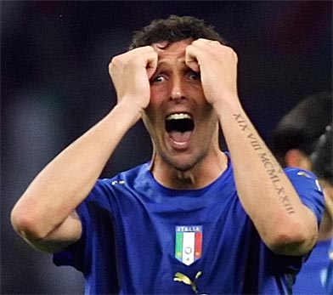
Gestures

Slide 10
Hands Clenched together

Slide 11
Steepling Hands

Slide 12
Gripping hands, wrist, elbow

Slide 13
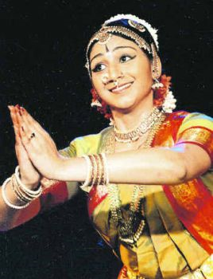
Narrative in dance (gestures)

Slide 14
Haptics

Slide 15
Paralanguage
Anthropologist George Tager coined the term paralinguistics to refer to something in speech beyond language itself.

Slide 16
Paralinguistics
Voice qualities: pitch, rhythm, resonance, range, speaking rate
Vocal characterizers: laughing, crying, whispering, groaning, whining, coughing, clearing the throat
Vocal Qualifiers: Variations in volume and pitch (loud-soft, high-low)
Vocal segregates: nonfluencies like ‘ah’ ‘umm’ ‘er’

Slide 17
Proxemics

Slide 18
Informal space (interpersonal)

Slide 19
Chronemics

Slide 20
Shhhhh…..

Slide 21
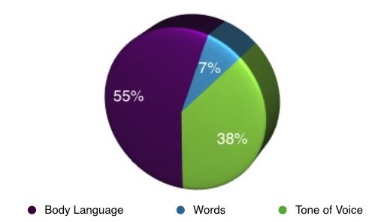
Comment (250 words)

