Slide 1
METHODS OF ASSESSMENT
Attendance 05
Quizzes, Case Study, etc 15
Seminar & exam 20
Final exam 60
Total 100

Slide 2
Reference Books:
Essentials of Management
  Harold Koontz & Heinz Weihrich
Management
  Heinz Weihrich, Mark V Cannice, Harold Koontz
Management
  By James Arthur Finch Stoner, Freeman R, Jr Gilbert Daniel R

Slide 3
By the end of today's session you will understand………
1) Why learn Management, What is Management?
2)Meaning, definition, objectives and importance of
Management
3) Nature of Management
4)Functions of Management
5) Who are managers?
6) Role of Managers, Managerial skills

Slide 4
Why study this subject?
1)To understand the process of business management and its functions, and
2) To familiarize the students with current management practices. .
3) To understand the importance of ethics in business, and
4) To acquire knowledge and capability to develop ethical practices for effective management.

Slide 5
Introduction to Management
Chapter
1

Slide 6
Why Study
Management?
Notes:
The Value of Studying Management
The universality of management
Good management is needed in all organizations.
The reality of work
Employees either manage or are managed.
Rewards and challenges of being a manager
Management offers challenging, exciting and creative opportunities for meaningful and fulfilling work.
Successful managers receive significant monetary rewards for their efforts.

Slide 7
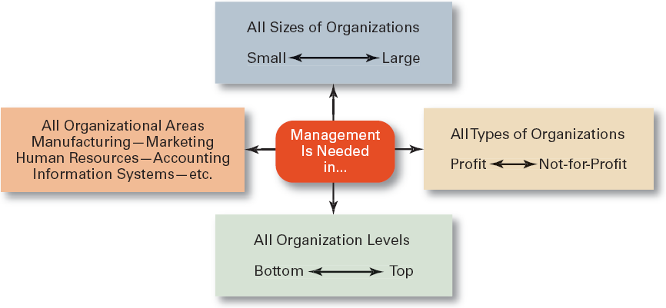
Need for Management?

Slide 8
Who Are Managers?
Manager
  Someone who coordinates and oversees the work of other people so that organizational goals can be accomplished.

Slide 9
Definition of Management:
Management is the process of designing and maintaining an environment in which individuals, working together in groups, efficiently accomplish selected aims.

Slide 10

What Is An Organization?
An Organization Defined
  A deliberate arrangement of people to accomplish some specific purpose (that individuals independently could not accomplish alone).
Common Characteristics of Organizations
  Have a distinct purpose (goal)
  Composed of people
  Have a deliberate structure

Slide 11
Managerial Concerns:
  Efficiency
    “Doing things right”
      Getting the most output for the least inputs
  Effectiveness
    “Doing the right things”
      Attaining organizational goals

Slide 12
Efficiency and Effectiveness in Management
Efficiency (Means)
Effectiveness (Ends)
Resource
Usage
Goal
Attainment
Low Waste
High Attainment
Management Strives For:
Low resource waste (high efficiency)
High goal attainment (high effectiveness)

Slide 13
0
Managers have to cope with diverse and far-reaching challenges
To keep pace with ever-advancing technology
To find ways to incorporate the Internet and e-business into their strategies and business model
Strive to remain competitive in a dynamic and far reaching world

Slide 14
Managerial Levels
Top Line
Managers
Middle Line Managers
First Line Managers
Non – Managerial Employees
Notes:
First-line managers hold positions like office manager, shift supervisor, or department manager.
First-line managers are the only managers who don’t supervise other managers.
They are closest to employees and have daily contact with employees.
Are at the lowest level of management and manage the work of nonmanagerial employees
Middle managers hold positions like plant manager, regional manager, or divisional manager.
Note how middle managers’ responsibilities are influenced by those of top managers.
Note also how their responsibilities are more narrowly focused than of top managers.
Manage the work of first-line managers
Top managers hold positions like chief executive officer (CEO) or chief operating officer (COO) and are responsible for the overall direction of the organization.
Are responsible for making organization-wide decisions and establishing plans and goals that affect the entire organization

Slide 15
Levels of Management
Top Level Management
Middle Level Management
First-Line
Management
Notes:
The jobs and responsibilities of the four kinds of managers are shown in Exhibit 1.2.

Slide 16
Top Managers
Responsible for…
Creating a context for change
Developing attitudes of commitment
and ownership in employees
Creating a positive organizational
culture through language and action
Monitoring their business environments
Notes:
Top managers hold positions like chief executive officer (CEO) or chief operating officer (COO) and are responsible for the overall direction of the organization.

Slide 17
Middle Managers
Responsible for…
Setting objectives consistent with top
management goals, planning strategies
Coordinating and linking groups,
departments, and divisions
Monitoring and managing the performance
of subunits and managers who report to them
Implementing the changes or strategies
generated by top managers
Notes:
Middle managers hold positions like plant manager, regional manager, or divisional manager.
Note how middle managers’ responsibilities are influenced by those of top managers.
Note also how their responsibilities are more narrowly focused than of top managers.

Slide 18
First-Line Managers
Responsible for…
Managing the performance of
entry-level employees
Teaching entry-level employees
how to do their jobs
Making schedules and operating plans based on
middle management’s intermediate-range plans
Notes:
First-line managers hold positions like office manager, shift supervisor, or department manager.
First-line managers are the only managers who don’t supervise other managers.
They are closest to employees and have daily contact with employees.

Slide 19
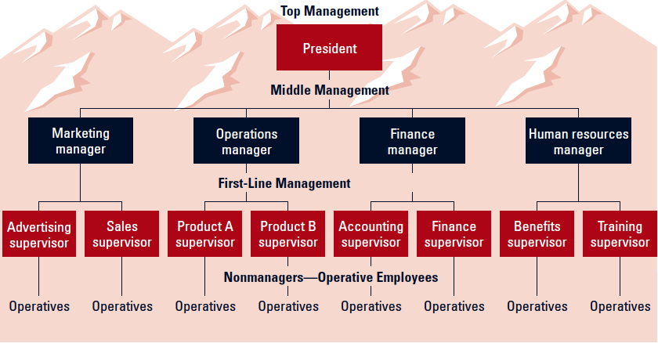
Management Levels and Functional Areas

Slide 20
Types of Managers
General Managers
  Supervise the activities of several departments.
Functional Managers
  Supervise the activities of related tasks.
  Common functional areas:
    Marketing
    Operations/production
    Finance/accounting
    Human resources/personnel management
Project Managers
  Coordinate employees across several functional departments to accomplish a specific task.

Slide 21
What Do Managers Do?
Functional Approach
  Planning
    Defining goals, establishing strategies to achieve goals, developing plans to integrate and coordinate activities.
  Organizing
    Arranging and structuring work to accomplish organizational goals.
  Leading
    Working with and through people to accomplish goals.
  Controlling
    Monitoring, comparing, and correcting work.

Slide 22
Resources
Human
Financial
Raw Materials
Technological
Information
Planning
Organizing
Select goals and ways to attain them
Assign responsibility for task accomplishment
Performance
Attain goals
Products
Services
Efficiency
Effectiveness
Controlling
Leading
Monitor activities & make corrections
Use influence to motivate employees

Slide 23


Slide 24
What Do Managers Do? (cont’d)
Skills Approach
  Technical skills
    Knowledge and proficiency in a specific field
  Human skills
    The ability to work well with other people
  Conceptual skills
    The ability to think and conceptualize about abstract and complex situations concerning the organization

Slide 25
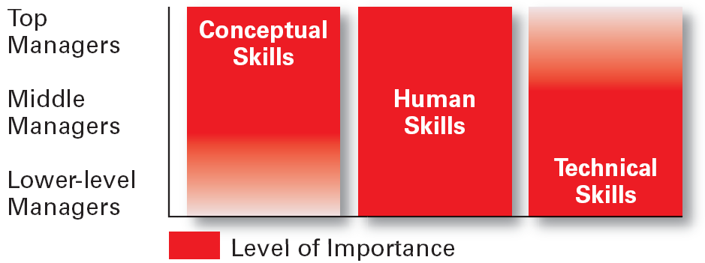
Skills @ Different Management Levels
Notes:
Conceptual Skills:
Using information to solve business problems
Identifying of opportunities for innovation
Recognizing problem areas and implementing solutions
Selecting critical information from masses of data
Understanding of business uses of technology
Understanding of organization’s business model

Slide 26
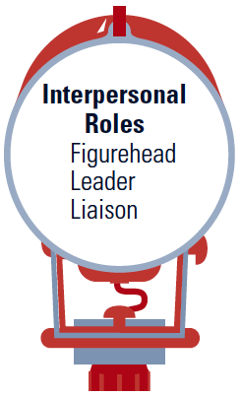
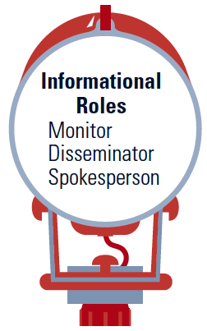
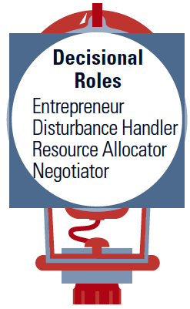
Managerial Roles Approach (Mintzberg)
Managers play various roles as necessary while performing their management functions so as to achieve organizational objectives.

Slide 27
What Companies Look for in Managers
Technical
Interpersonal
Conceptual
Diagnostic
Communication
Decision-Making
Time-Management
Notes:
17

Slide 28
New Workplace Issues and Challenges
Technology and Speed
Networking and
Boundaryless
Relationships
Globalization
and Diversity
Ethics and
Social
Responsibility
Knowledge,
Learning,
Quality, and
Continuous
Improvement
Participative Management,
Empowerment,
and Teams
Knowledge
Management
Change, Creativity, Innovation,
and Entrepreneurship

Slide 29
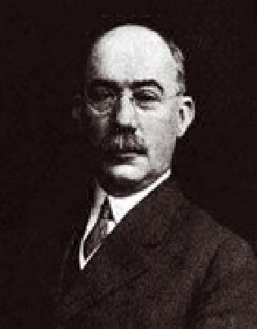
14 Principles of Management

Slide 30



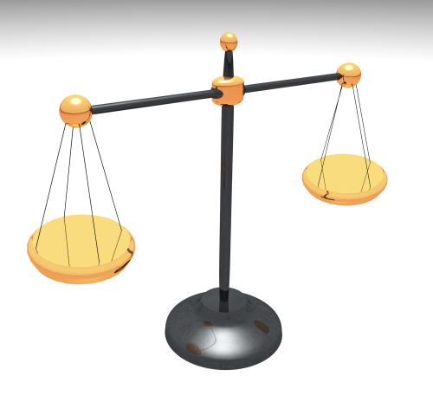
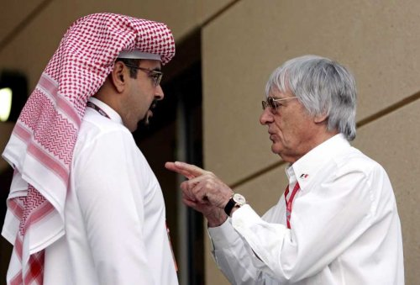


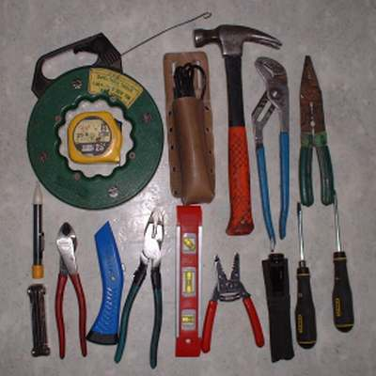
1. Division of Labor
2. Authority & Responsibility
7. Discipline
5. Equity
4. Unity of Direction
3. Unity of Command
6. Order
Notes:
Work of all kinds must be divided & subdivided and allotted to various persons according to their expertise in a particular area.

Slide 31

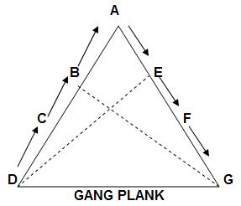





8. Initiative
10. Stability of Tenure
11. Scalar Chain
13. Espirit De’ Corps
9. Remuneration
12. Sub-Ordination of Individual Interest to common goal
14. Centralization
Notes:
Initiative means eagerness to initiate actions without being asked to do so.
Management should provide opportunity to its employees to suggest ideas, experiences& new method of work.

