Slide 1
Business Correspondence

Slide 2
Principles of Correspondence
Correct
Concise
Conversational
Credible
Clear
Courteous
Creative

Slide 3
Elements of Format
Heading
Date
Reference Number
Inside address
Attention line
Salutation
Subject
Main body
Complimentary close
Signature block
Enclosures
Copy

Slide 4
Formatting Styles
Complete Block
Modified Block/ Block
Semi Block

Slide 5
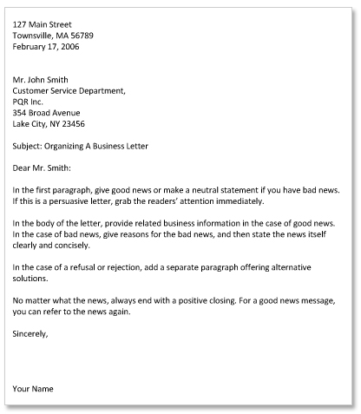
Content Division

Slide 6
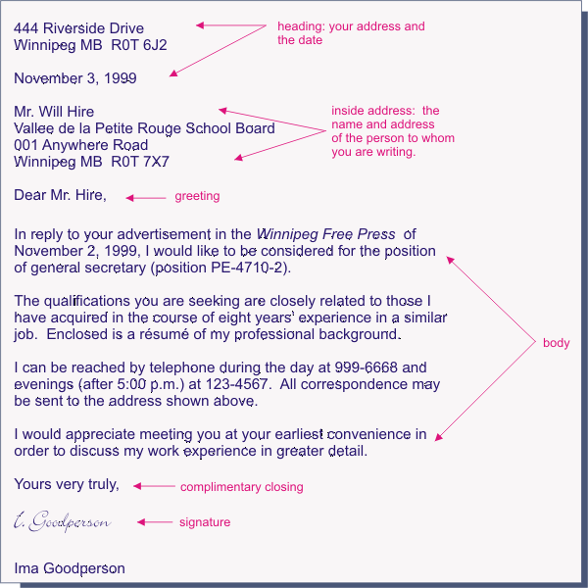
Complete Block Style

Slide 7
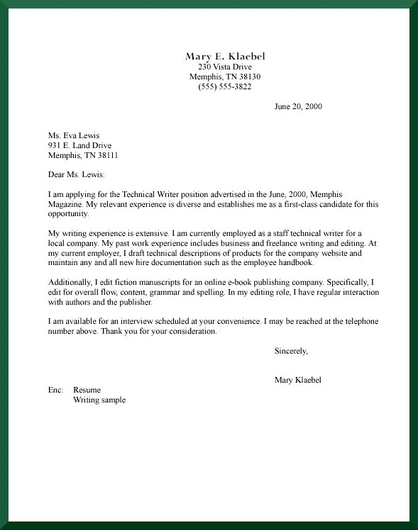
Modified Block/ Block

Slide 8
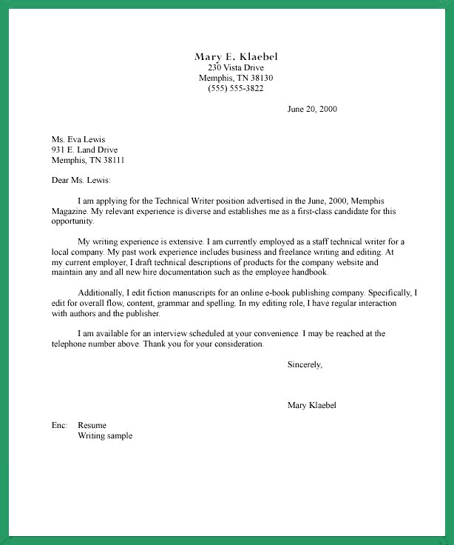
Semi-Block Style

Slide 9
E-mail Writing

Slide 10
Dos
Check your organisation’s email policy
Pay heed to content
Be relevant
Be polite
Trim quoted messages
Use humour and sarcasm sparingly
Include a subject line
Quote from original message where necessary

Slide 11
Dos (cont…)
Be patient with new email users
Use a brief signature
Be careful while replying to mailing list messages
Delete what’s trivial
Make a note of format of attachment in the body
Use emphasis where necessary
Pay attention to spellings and style
Fill the “To” section in the end

Slide 12
Don’ts
Don’t reply to a mail when angry
Don’t retain the original in a reply unless necessary
Don’t use CAPITALS
Don’t over-use punctuation……!!!
Don’t send large attachments without checking with the receiver
Don’t send chain letters

Slide 13
Don’ts (cont…)
Don’t argue on mails
Please avoid public ‘flames’
Don’t mark things urgent if they aren’t
Don’t make personal remarks
Don’t use cute or suggestive email addresses
Don’t criticize people’s spellings

