Slide 1
BINGO

Slide 2
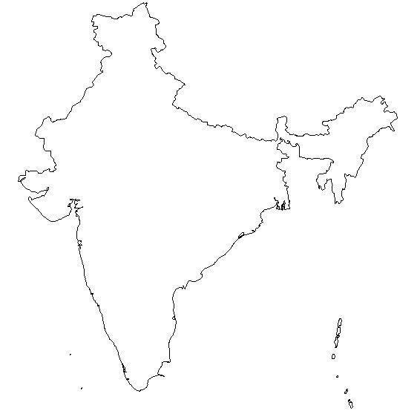
Segmentation
Geography
North
South
East
West
Plain Salted
Taste
Salted
Mustard sting
Nimbu
Chilly
Mustard Sting
Nimbu Flavour
Spicy Red/ Chilly
Notes:
Regional/geographic segmentation

Slide 3
Segmentation
Demographic (Age)
Targeting
Age class
12-20
20-35
35-50
>50
Psychographic (Attitude/Behavior)
Conservative, reserved, shy
Outgoing, Fun loving, Bindass

Slide 4
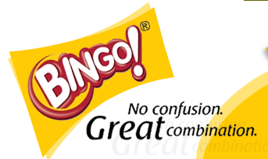
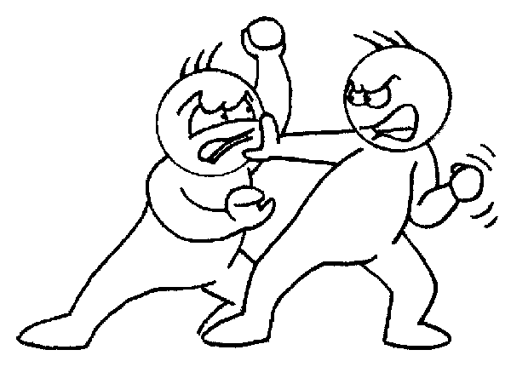
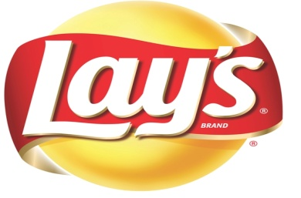
Positioning
Bingo! is positioned as a youthful and innovative
snack, offering the consumers with choice in terms
of both formats and flavors including Local tastes.
Crisp and Clear Punch line
Lays is positioned as a very good quality snack with international taste.
No one can eat just One..!

Slide 5
Market share: Organized Sector
Before the launch of Bingo, Mar 07
After the launch of Bingo, Dec 08
Notes:
A value proposition is an analysis and quantified review of the benefits, costs and value that an organization can deliver to customers and other constituent groups within and outside of the organization. It is also a positioning of value, where Value = Benefits - Cost (cost includes risk)
Value propositions can be used to position value to a range of constituents such as:
Customers – to explain why a customer should buy from a supplier (see customer value proposition).
Partners - for the purposes of strategic alliances or joint ventures.
Internal departments – for example where an I.T. department is creating an internal business case to present to the board for funding.
Employees – for recruiting new people or for retaining and motivating existing employees. This is sometimes called the H.R. (Human Resources) or employee value proposition.
Suppliers – to explain why a supplier should want to be a supplier to an organisation or customer.

Slide 6
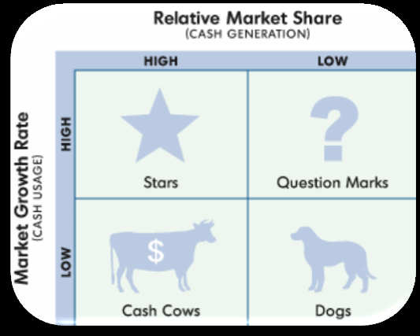

Slide 7
What’s in my name ?? (brand name)
Easy to pronounce
Recallable
Exclamation Mark
Trendy and Fun
Catchy
Notes:
Bingo has a unique musical sound that is loved by everyone.
It is one of the properties that is remembered by everyone and it is used to recall the brand by every age group.

Slide 8
brand property
Bingo has a unique musical sound that is loved by everyone.
It is one of the properties that is remembered by everyone and it is used to recall the brand by every age group.

Slide 9
Brand identity Prism
ITC,
Shapes,
Games, Poing!!!
Innovative,
Experimentative
Physique
Personality
Outgoing, Fun loving
Indian,
Different
Relationship
Culture
Customer’s Reflection
Customer’s Self-projection
Cool,
Young at heart
I am Bindaas!!!

